Slide 1
University at Buffalo SI
Austin Keppler / Austin Ocwieja

Slide 2
Last Years Results
Bearcat 3000 Chassis
700 Ctec4 2 cylinder four stroke engine
Exhaust manifold failure during endurance event

Slide 3
2019 Clean Snowmobile Strategy
Build a snowmobile that can be built upon in future years
Sustain performance characteristics that would make the snowmobile marketable
Focus on reducing noise output of both the engine and chassis

Slide 4
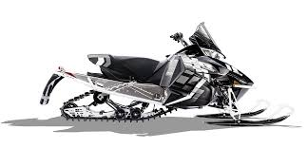
Chassis
2017 ZR 3000
Lightweight
Trail suited
Same basic platform as previous year

Slide 5
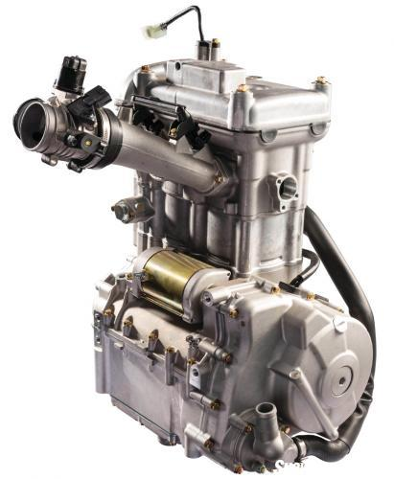
Engine
Arctic Cat Ctec4
700cc 2 Cylinder Four Stroke

Slide 6
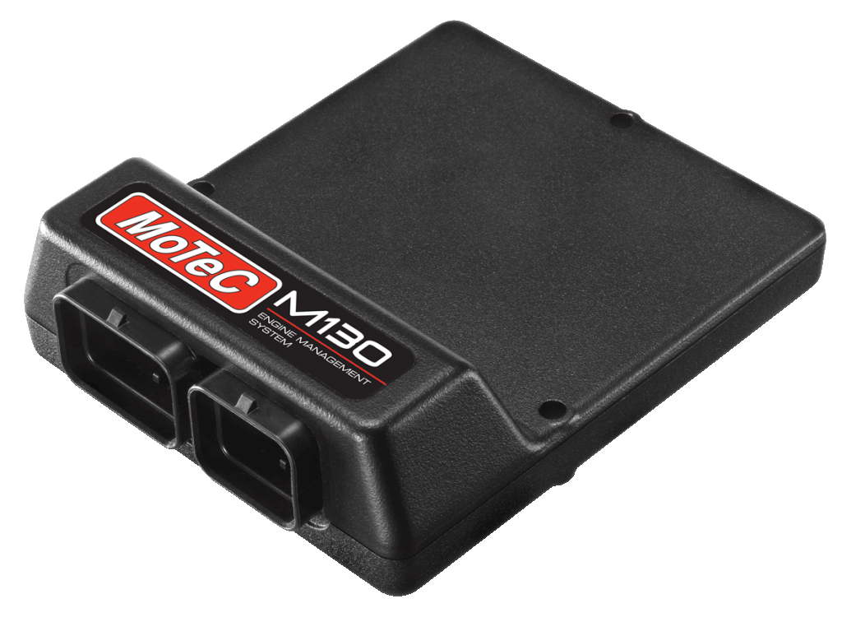
Engine Management
Motec M130
Closed Loop Fuel Tuning
Flex Fuel Compatable
Tuned to run at stoichiometric combustion

Slide 7
Turbocharger
BorgWarner KP 35
$Pressure Ratio=\frac{P­_{boost}+P_{atm}}{P_{atm}}$
$CFM=\frac{\frac{1}{2} Engine Displacement∗Max RPM ∗V.E.∗ D.R. }{1728}$
Utilize these parameters to locate efficiency on compressor map

Slide 8
Exhaust
Factory Exhaust Manifold
Precision Turbo Wastegate
Honda Muffler
3 Way Magnaflow Catalytic Converter
Custom Built Resonator

Slide 9
Resonator
$f=\frac{c}{2π}∗\sqrt{\left(\frac{A}{V∗L}\right)}$
Identified droning frequency around ~59 - 60 Hz

Slide 10
Resonator

Slide 11
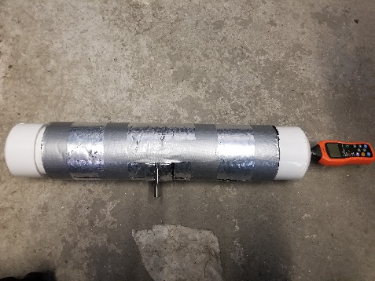
Chassis Noise Reduction
Tested several different materials
Foam
Lizard Skin
Spray Paint
Enclosed test fixture

Slide 12
Test Results

Slide 13
Conclusion
Successfully created a low noise emitting snowmobile
Unfortunately ran into small undetected problems that led to the failure of the snowmobile

Slide 14
Thank You
Austin Keppler – Mechanical Engineering / MBA
alkepple@buffalo.edu
Austin Ocwieja – Mechanical Engineering / MBA
austinoc@buffalo.edu

