Slide 1
2018 CSC Design Presentation
UMD R & Diesel Engineering Team

Slide 2
Who We Are
Samuel Wick – President
Blake Thurnbeck – Engine Packaging
Karter Klingsporn – Fuel Management
Tucker Johnson – Electrical Lead

Slide 3
Goals
Build Clean, Quiet, and Efficient Diesel Powered Snowmobile
Utilize stock arrangements for engine and chassis
Create a snowmobile that fulfills market needs

Slide 4
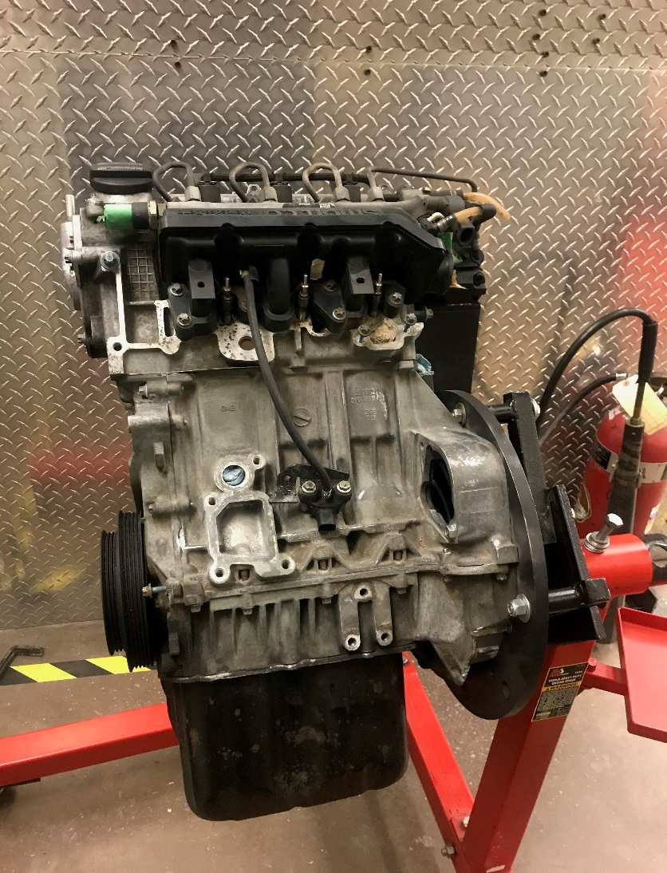
Engine Selection
Mercedes OM 660
799 cc with an output of 40 HP at 3800 RPM
Common Rail- Direct Injection
Turbocharged
Weight to Performance improvement over mechanical injection

Slide 5
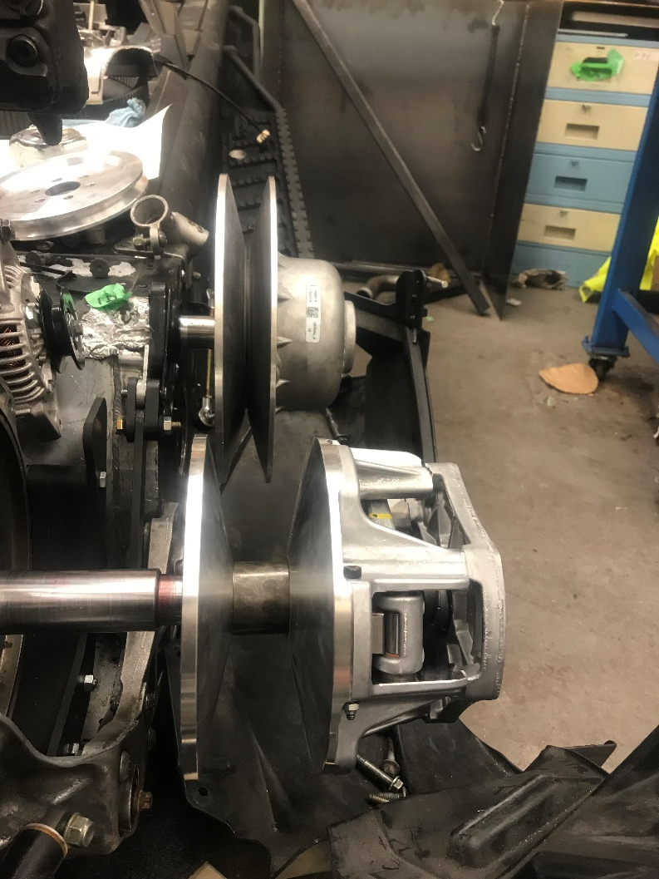
Engine Adaptations
Engine Mounts
Drive train
Alternator and Water Pump

Slide 6
Mercedes OM 660
Displaced volume | 799 cc
Stroke | 79 mm
Bore | 65.5 mm
Cylinder Angle | 45°
Compression ratio | 18:1
Number of Cylinders | 3 in-line
Dry Weight | 86.18 kg (190 lbs.)
Est. Running Weight | 90.71 kg (200 lbs.)
Rated Output | 33 kW @ 3800 RPM
Rated Torque | 110 N*m @ 2000 RPM
Camshaft Configuration | Overhead-single
2018 UMD R & Diesel

Slide 7
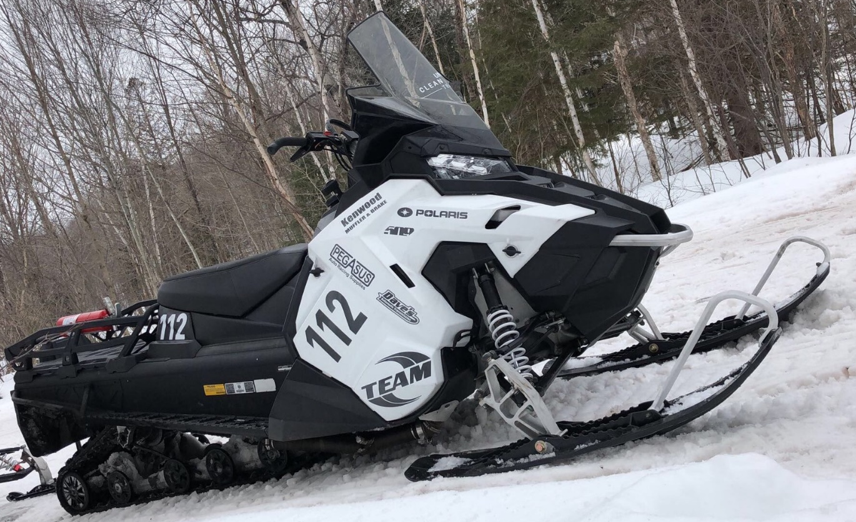
Chassis Selection
Axis Chassis
Polaris Titan SP
Alpha Transmission
Towing Capabilities
2018 UMD R & Diesel

Slide 8
Engine Packaging
Cooling Package
Intake Air System
Limited Hood Space
Auxiliary Oil Pump
Fuel Supply
2018 UMD R & Diesel

Slide 9
Exhaust
Catalytic Converter
Passive Diesel Particulate Filter
Heat Isolation
Exhaust Wrap
Aerogel Shields
2018 UMD R & Diesel

Slide 10
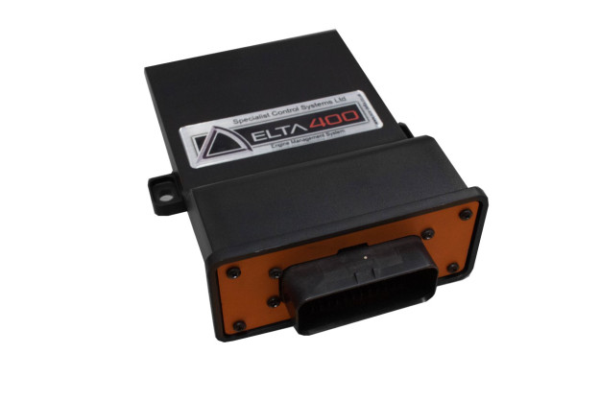
Wiring and Computer
Specialty Components Delta 400 ECU and Piezo Injector Driver Module
SX Tune
Combining Wiring Harness of Engine and Snowmobile
2018 UMD R & Diesel

Slide 11
Unexpected Challenges
Oil Relocation
Faulty Injector
Failing Injector Driver Module
2018 UMD R & Diesel

Slide 12
Summary
Mercedes OM660 mounted in Polaris Titan SP
Custom cooling pack to maintain engine temperatures under heavy loads
Oxidation Catalyst used to reduce CO levels by up to 90%, HC up to 80% and PM up to 20%
DPF installed to reduce soot
Maintained original geometries
2018 UMD R & Diesel

Slide 13
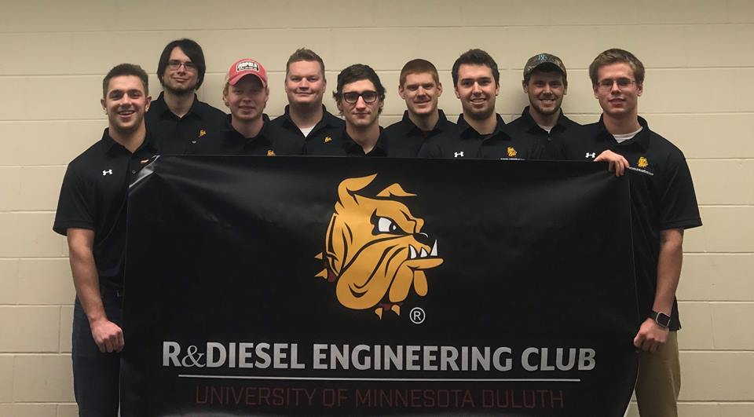
Thanks!
2018 UMD R & Diesel

