Slide 1
University of Minnesota Duluth 2015 SAE Clean Snowmobile Challenge
Presented by:
Dylan Dahlheimer
Ryan Schefers
Brenden Bungert
Mark Boeckmann
UMD
University of Minnesota Duluth
Notes:
Brandon

Slide 2
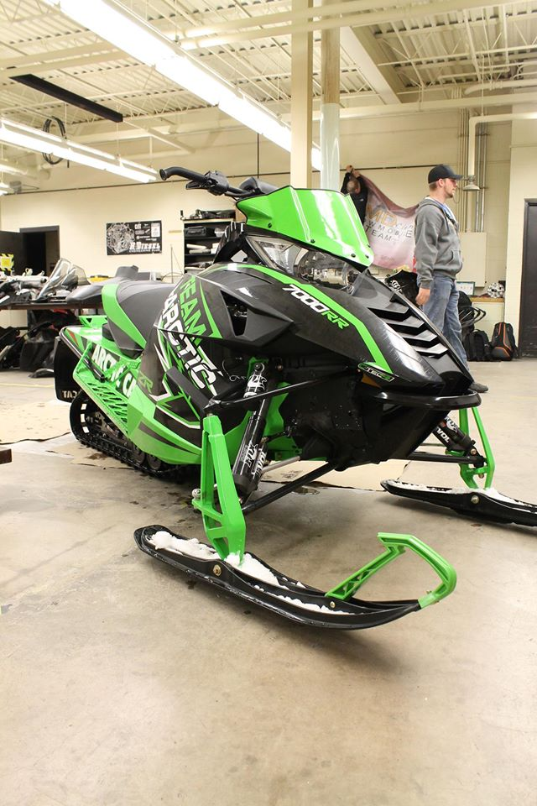
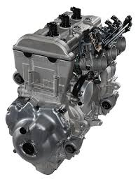
Snowmobile Overview
2015 Arctic Cat ZR 7000 RR
Lightweight ProCross Chassis
Yamaha Genesis 130 FI
1049cc over 3-cylinders
EPA rated: 124 horsepower
Non-BAT compliant
UMD
University of Minnesota Duluth
Notes:
Joe

Slide 3
Marketing Appeal
Emissions reduction
Decreased sound
Outstanding performance
Integrating Flex-Fuel capabilities
More power to the ground
Reliability validation
UMD
University of Minnesota Duluth
Notes:
Brandon

Slide 4
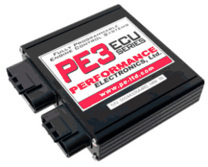
Engine Control Methods
Standalone ECU
Performance Electronics PE3 ECU
Wide-Band O2 Sensor
Flex Fuel Sensor
Temperature based compensations
Lambda based tuning
UMD
University of Minnesota Duluth
Notes:
Kyle L

Slide 5
Tuning Strategies
MBT ignition timing
Optimized air/fuel ratio
Reduced BSFC by 11.5%
4% increase in Volumetric Efficiency
UMD
University of Minnesota Duluth
Notes:
Kyle L

Slide 6
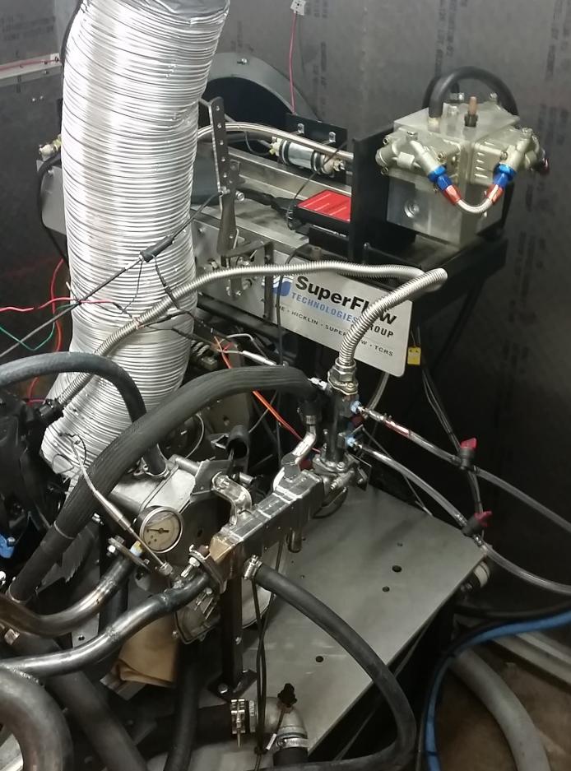
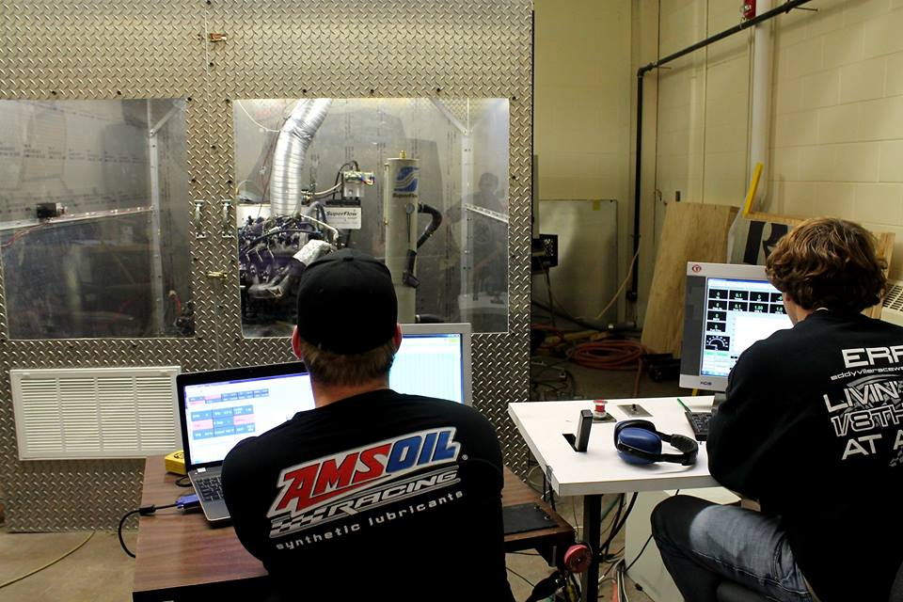
Dynamometer Testing
UMD
University of Minnesota Duluth
Notes:
Kyle L

Slide 7
Cooled Exhaust Gas Recirculation
Controlled from PWM motor
Sourced from Toyota Prius
Stacked style cooler
Load and RPM controlled through ECU
Integrated into exhaust pre-catalyst
Reduced NO_{x} by 64%

Slide 8
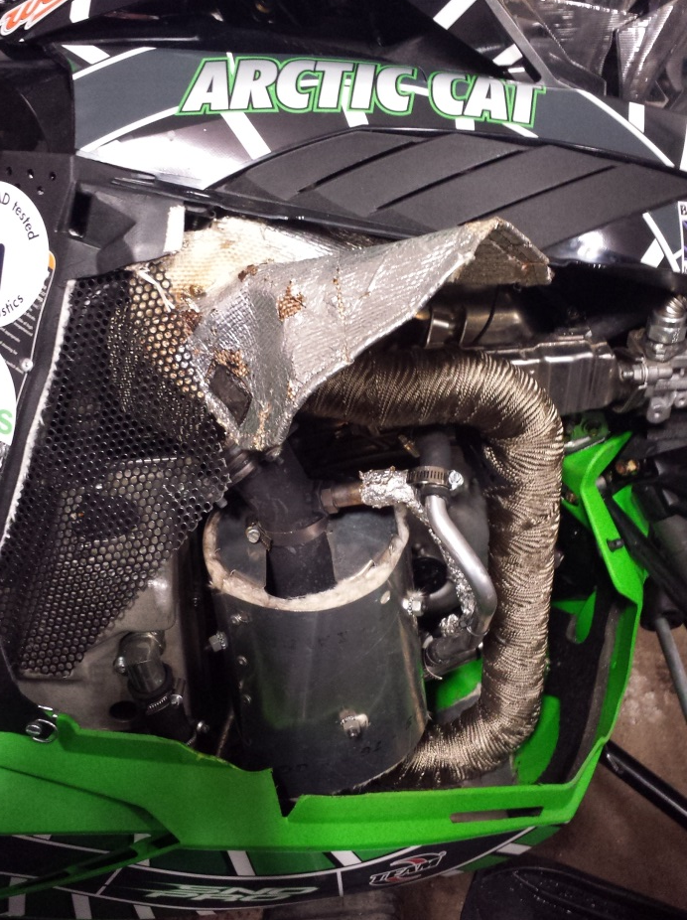
Emissions
Heraeus 3-way Catalyst
HeraPur Coating
Platinum, Palladium, and Rhodium
105 mm Diameter, 74.5 mm Length
Integrated heat shielding
Reduced Constituents
41.5% reduction in CO
53.6% reduction in HC
UMD
University of Minnesota Duluth

Slide 9
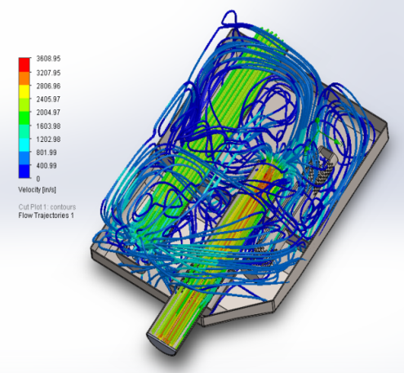
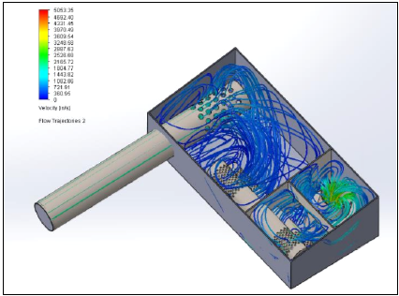
Noise Reduction
Stock:
Muffler Redesign
Stock resonator tubes
Lined with fiberglass
Increased backpressure
Inline baffle
SAE J192 Results: 77.9 dBA
Dynamat placement
New Design:
UMD
University of Minnesota Duluth
Notes:
Kyle S

Slide 10
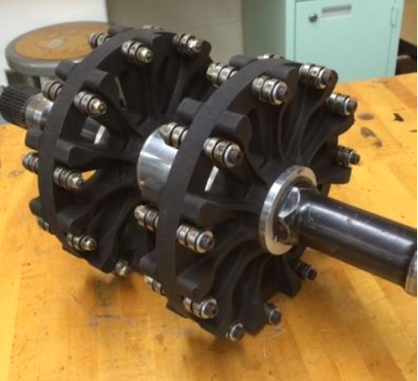
Drive Sprocket
Carbon Fiber filled Nylon 11
Ball bearing contact
2.52” Drive Pitch
Efficiency Increase of 6% through driveline
Incorporated braking lugs
Design FOS of 3
Reduction of 2.75 lbs. rotating mass from 2014
UMD
University of Minnesota Duluth
Notes:
Brandon

Slide 11
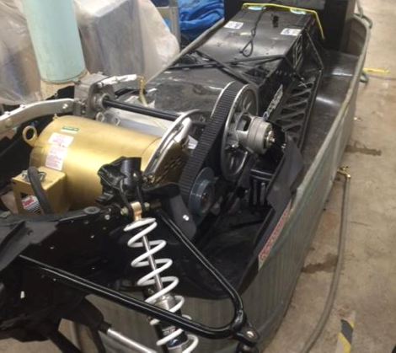
Chassis Dynamometer
10 hp electric motor
Variable Frequency Drive control
Water brake loading
Digital speedometer readout
Power input vs speed output curves
UMD
University of Minnesota Duluth
Notes:
Dylan

Slide 12
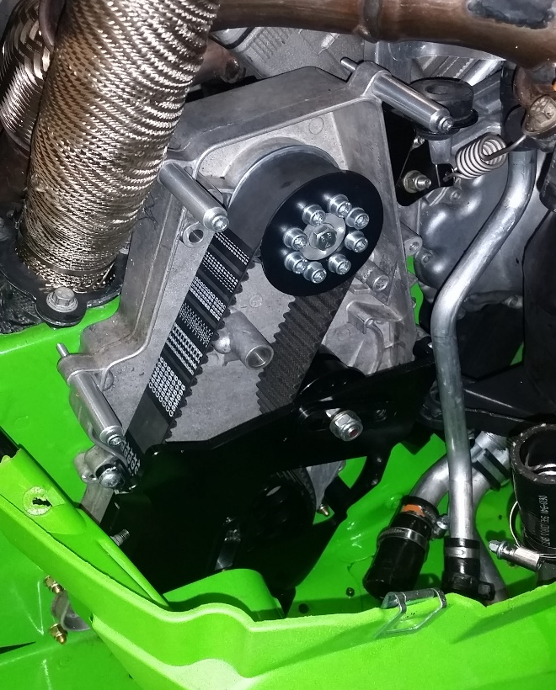
C3 Belt Drive with Quiet Drive Track
Belt drive to replace chain case
Reduces 11 lbs. of weight and 8 lbs. of rotating mass
128” Camoplast Hacksaw Quiet Track
1.080” Woody’s studs
Reduced track weight by 5 lbs.
UMD
University of Minnesota Duluth
Notes:
Brandon

Slide 13
Overall Efficiency Improvement
6.1% Overall Improvement

Slide 14
Project Overview
2015 Arctic Cat ZR 7000 RR
Standalone PE3 ECU with complete engine tune
3-way catalyst with integrated cooled EGR system
Carbon fiber roller drive sprocket
13.5% reduction in sound
6.1% driveline efficiency increase
250 Miles of on-snow validation
Fun, marketable sled with real world applications

Slide 15
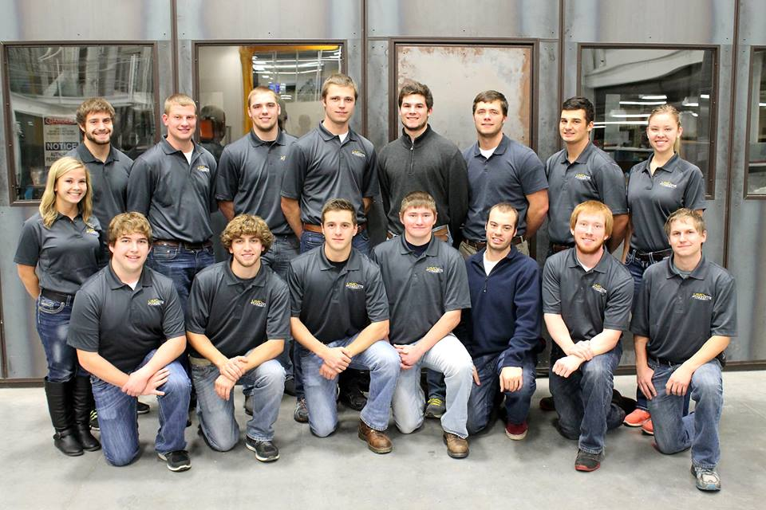
Thank You
UMD
University of Minnesota Duluth

