Slide 2
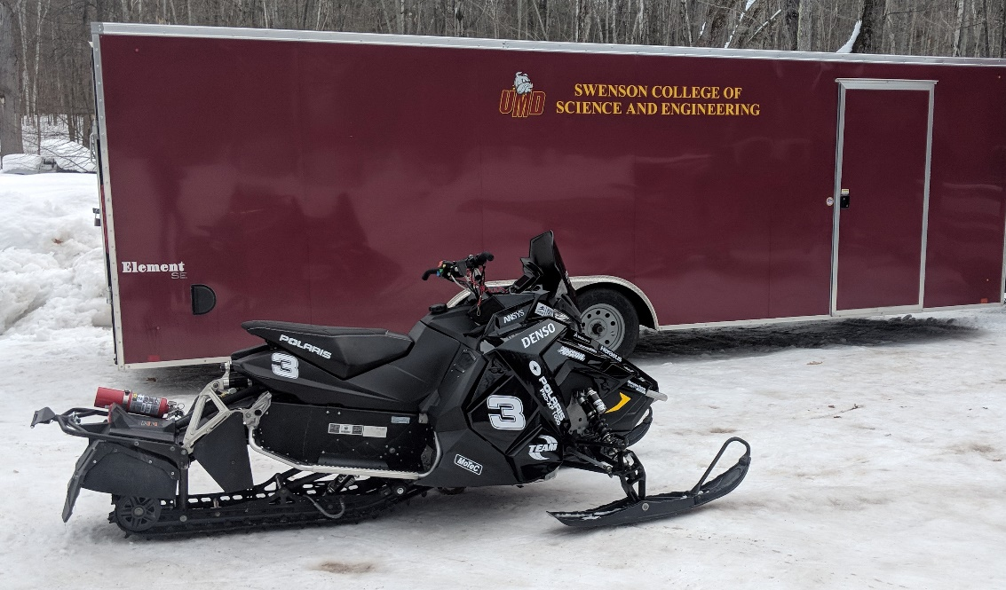
Last Year’s Foundation
Emissions controlled strategy provided great results
Most Practical Solution Award
High concentration of mass in the front of the machine
Packaging issues
Steering binding

Slide 3
Vision/Goals
Fun, marketable snowmobile
Build upon last year’s success
Practical, data driven approach
Increase rideability and handling
Quieter package
E-score above 200
80 horsepower class
15+ mpg

Slide 4
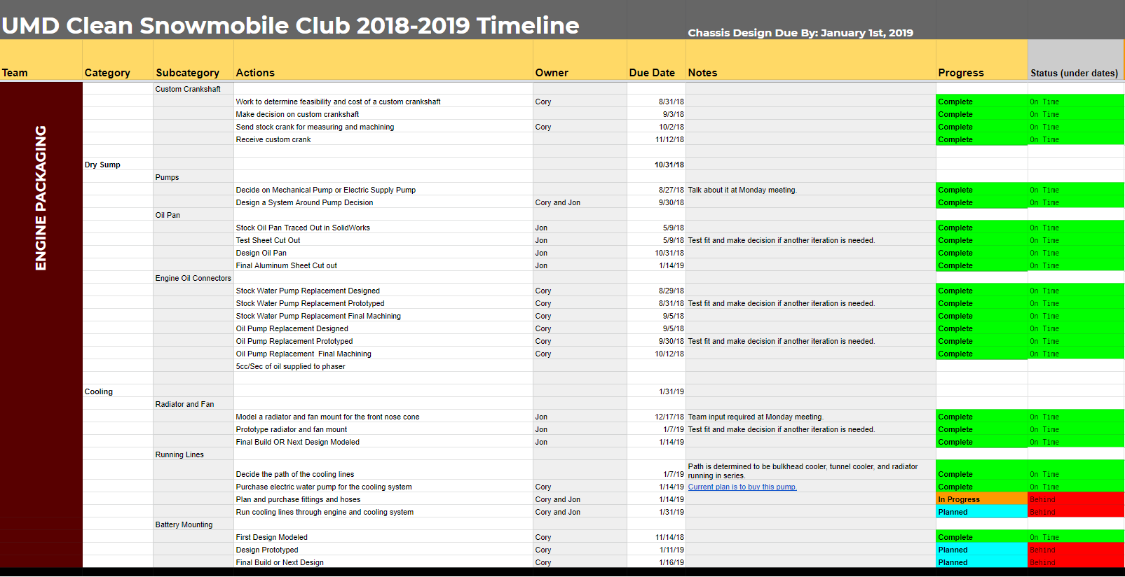
Team Management
Project Manager with individual Team Leads
Sophomores and Juniors hold leadership positions
Critical Design Reviews for major designs
Weekly update meetings through the summer and school year
Detailed Gantt Chart

Slide 5
Innovations
2019 Polaris Indy XC Chassis
GT Suite & ANSYS Simulation
Standalone MoTeC ECU
Rear exiting exhaust system
Dry sump oiling system
Tuned intake and exhaust designs
Started developing variable valve timing

Slide 6
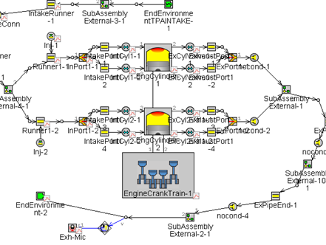
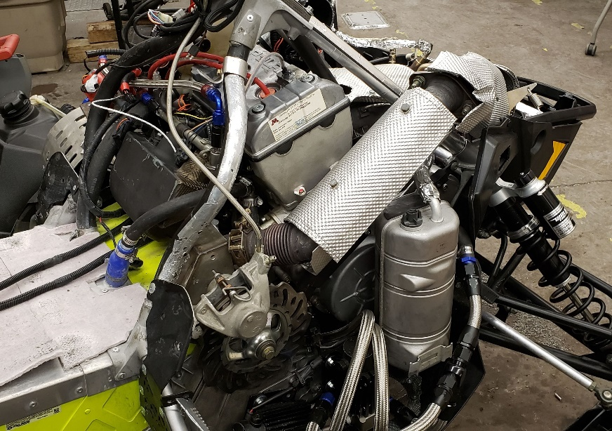
Engine Development
Polaris ProStar 1000
RZR cylinder head with Ranger camshafts
GT Suite 1D simulations
Tuned exhaust header
Tuned intake plenum
MoTeC M130 Standalone ECU
Electronic throttle control
3-way Catalyst
Variable Valve Timing

Slide 7
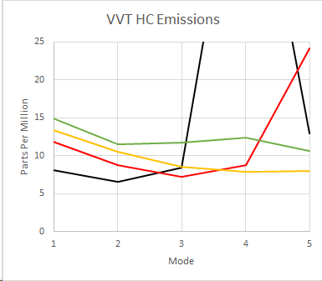
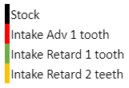
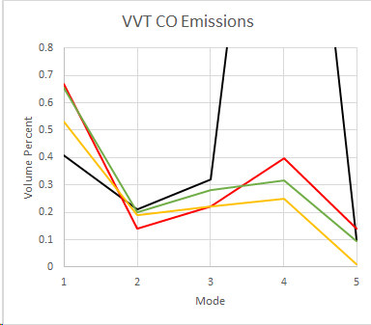
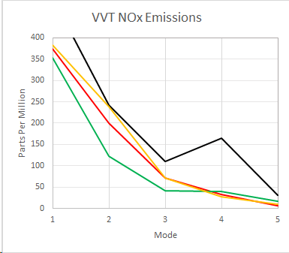
Variable Valve Timing

Slide 8
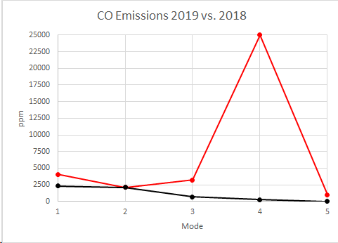
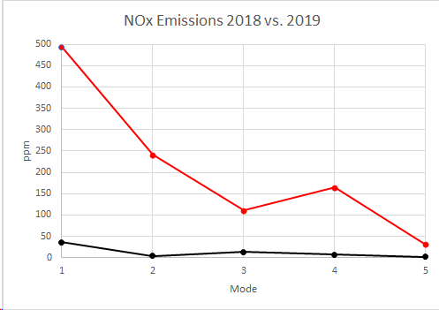
Dynamometer/Results
60kW (80 hp) measured
Hydrocarbons (HC) reduced 82% compared to last year’s engine package
Carbon Monoxide (CO) reduced 85%
Oxides of Nitrogen (NOx) reduced by 73%

Slide 9
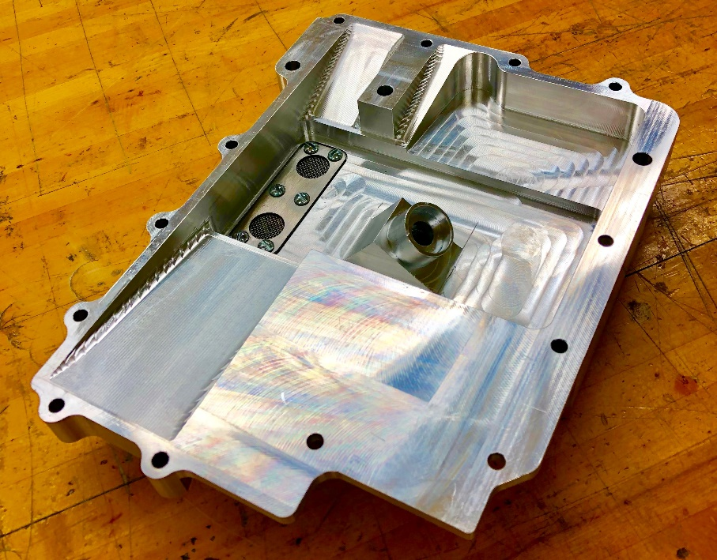
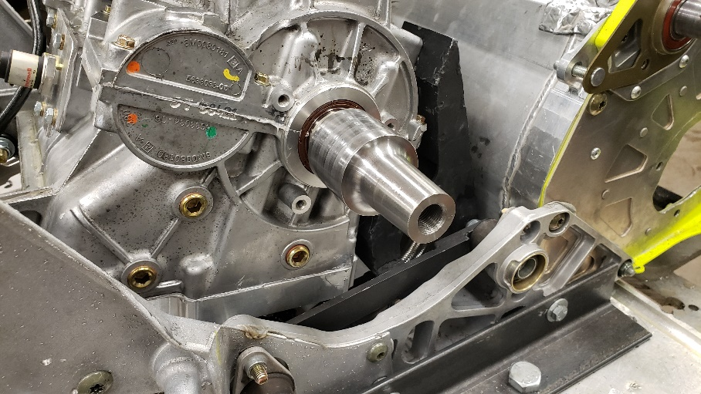
Powertrain Integration
Lowered center of gravity
Dry sump oiling system to lower engine
Crankshaft extension for clutch alignment
Improved clutch alignment

Slide 10
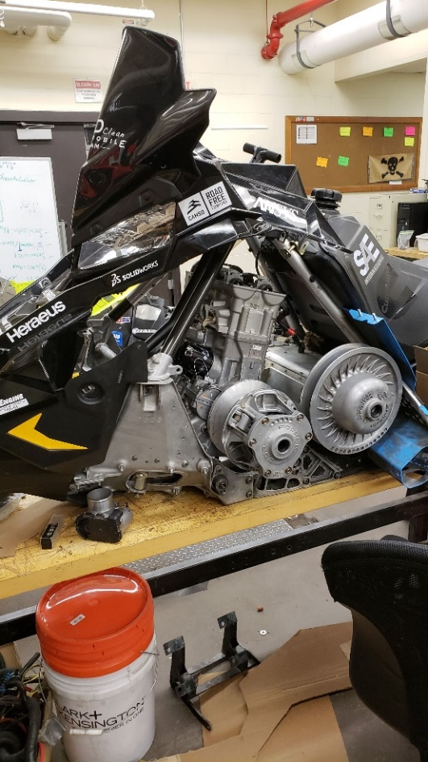
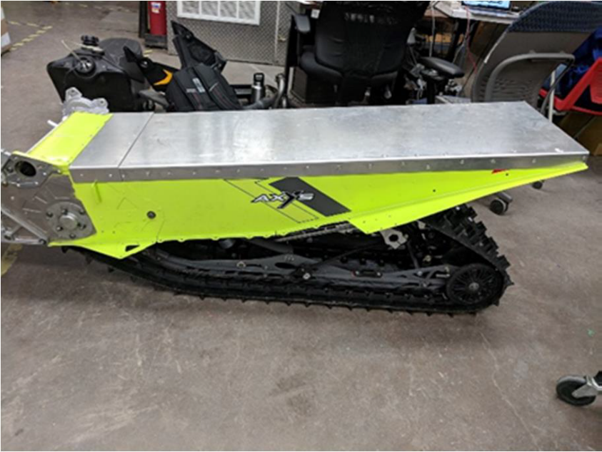
Chassis Integration
Factory mounting locations utilized
Redesigned front lower crossbar to assist in engine mounting
Steering utilizes straight shaft design
Custom tunnel

Slide 11
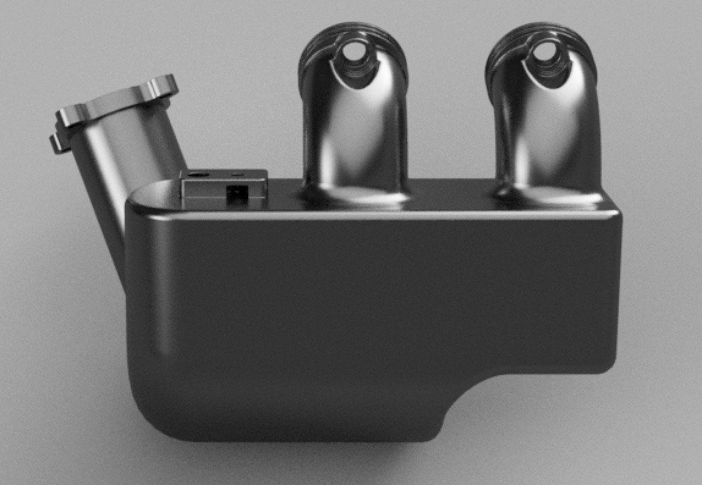
Intake
Designed using GT Suite & ANSYS Fluent
Designed to have better cylinder to cylinder volumetric efficiency
Utilized factory upper airbox

Slide 12
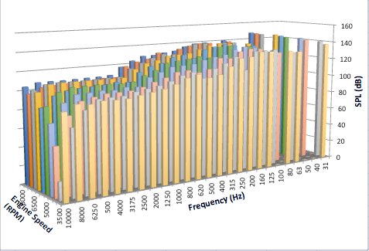
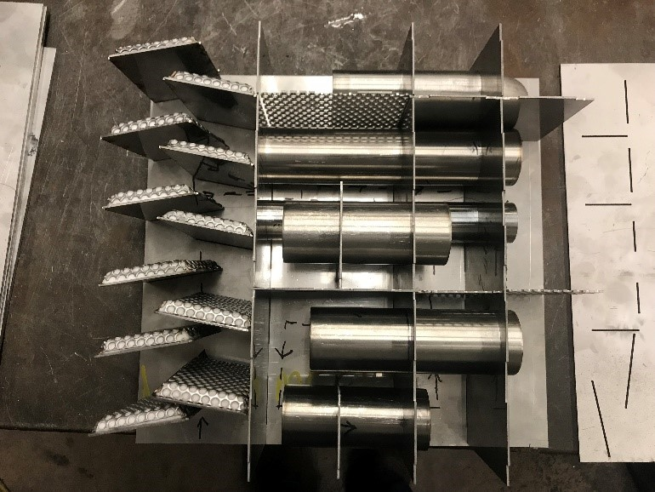
Silencer Development/Design
Dominant frequency identification
Quarter wavelength model used to design silencer
304 Stainless Steel
5-Stage multi-pass design
Destructive wave interference
Tuned baffles
Tunnel length resonator tube
Targets 11 dominant frequencies

Slide 13
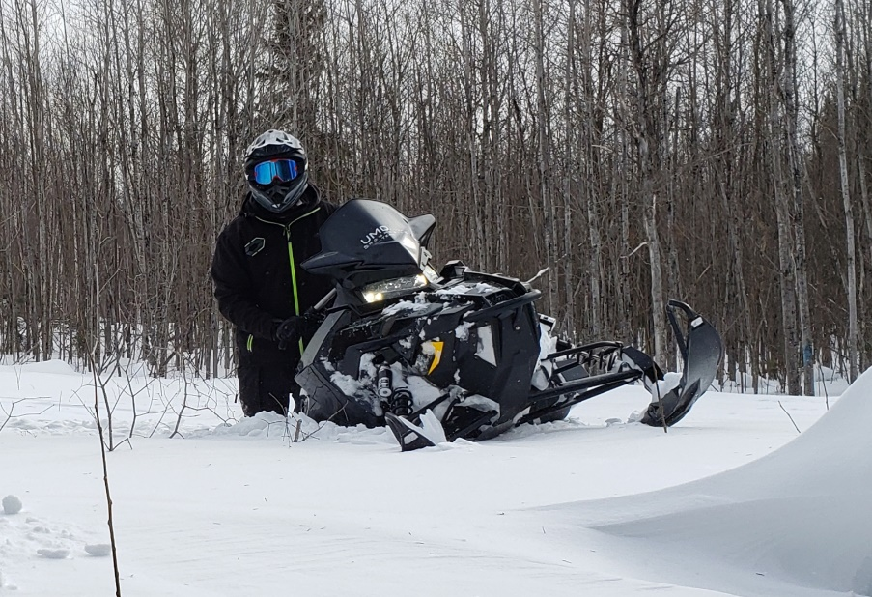
On-Snow Calibrations/Testing
Rideability & handling have been increased
Full clutch & suspension tuning
Calibration of E-Throttle using MoTeC data logging
Full transient engine tune & overrun fuel cutting
J1161 of 69 dBa
150+ miles of validation

Slide 14
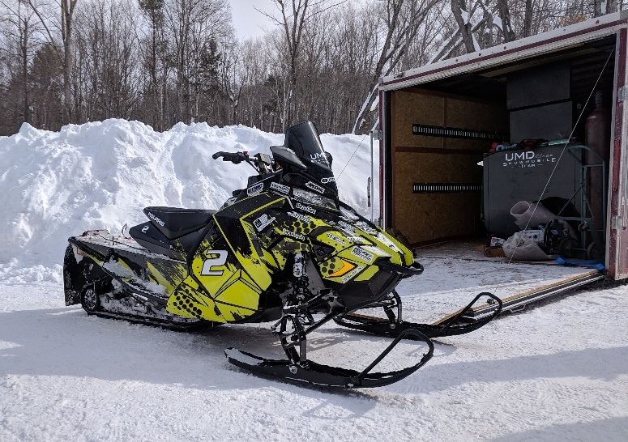
Summary
60kW (80 hp) enjoyable trail snowmobile
Improved handling & rideability
Reduced engine noise
80% reduction in emissions from last year
J1161 test of 69 dBa
Lowered MSRP to $11,499
Overall fun, marketable snowmobile

Slide 15
Thanks!

