Slide 1
Iowa State University
Design Presentation
3/8/2018
Alec Ehlke, Charlie Bootsmiller, Joe Regan

Slide 2
Content
Entry Description
Timeline and Team Management
Innovations
Results

Slide 3
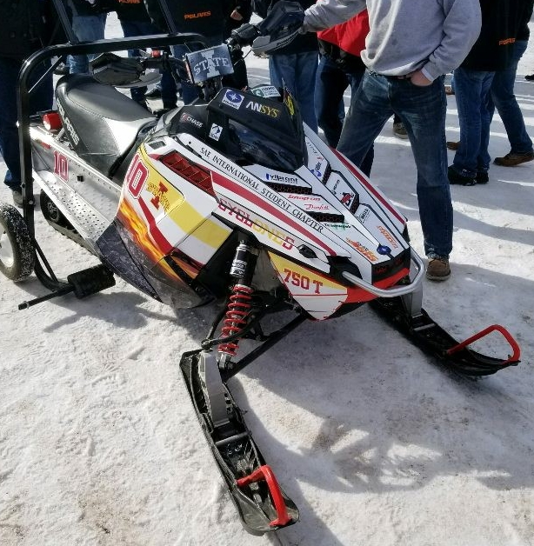
Entry Description
2014 Polaris 800 Indy SP
750cc Weber MPE Turbocharged
2 Chamber, Custom reactive muffler
Three-way catalytic converter
MS3 Pro Ultimate ECU [MegaSquirt]

Slide 4
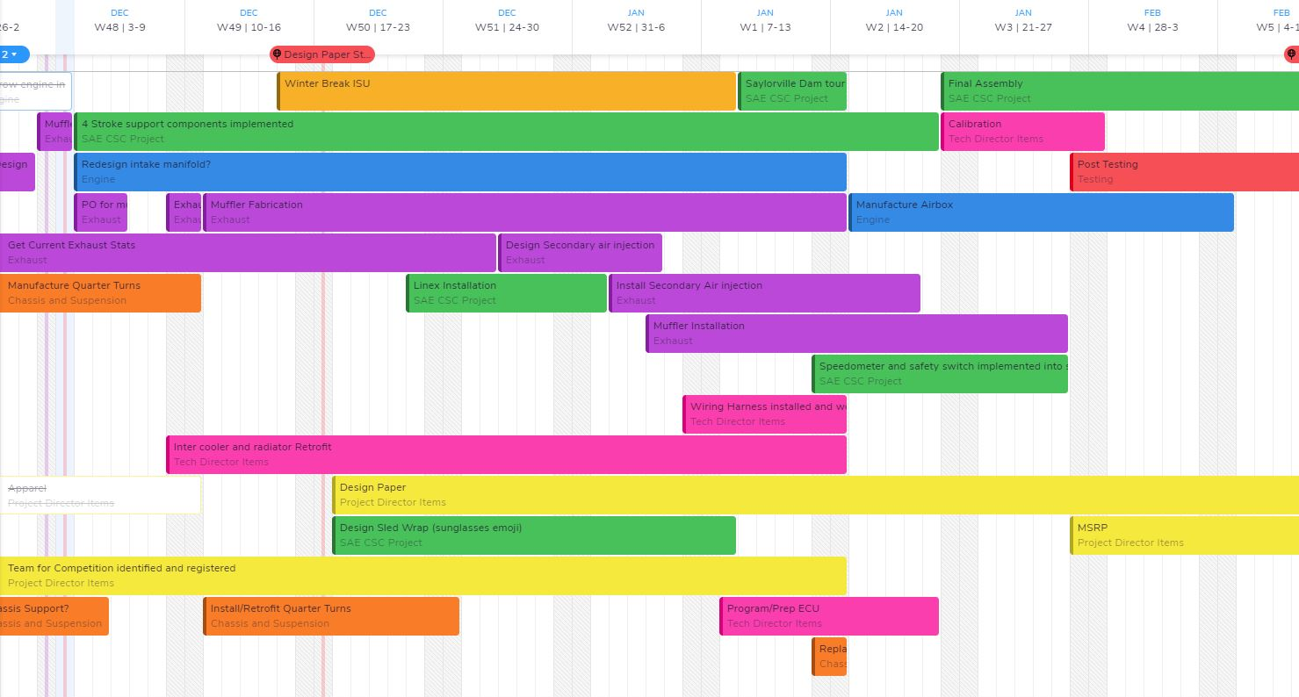
Timeline and Team Management
Timeline created at start of season
Tasks organized by sub-system team
4 sub-system teams
Improved Team’s ability to uphold specific deadlines
Notes:
At the beginning of the season, a timeline was created by the tech and project director in Teamweek. Once the timeline was created, the map was shared with the assorted team leaders, and their concerns were identified. Once all parties were in agreement, the timeline was solidified and teams were expected to meet their deadlines in order to stick to the pre-determined plan.

Slide 5
Innovations
2 - Stroke to 4 - Stroke engine swap
Custom Exhaust
304 Stainless Steel
Ceramic Foam insulation
Three-way Catalyst
3D metal printed downpipe
Standalone ECU
Skid and Body Modifications

Slide 6
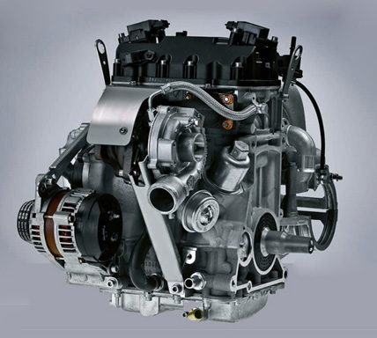
Baseline and Engine Selection
800 cc Liberty – 2 stroke
E-score of 76 [2015 results]
80 dBA [Custom muffler]
150 Stock Hp
750 cc Weber MPE - 4 stroke
E-score of 176 [RIT 2015]
77 dBA [Stock muffler]
120 Stock Hp
Notes:
Stock in the Indy chassis is a 2 stroke 800cc liberty engine. This engine was used in our 2016 competition, and was used as the baseline for testing in this year’s design.
80 dBA
193.7 E score
BSFC : 43.06

Slide 7
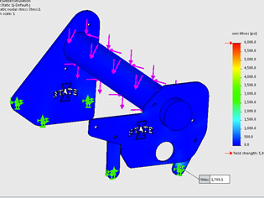
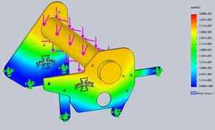
Engine Mounts
Engine mount prototyping
Finite Element Analysis
Load [S.F. of 2]
Natural Frequency - 133.33 rad/sec
Mode 1 Frequency - 493.66 rad/sec

Slide 8
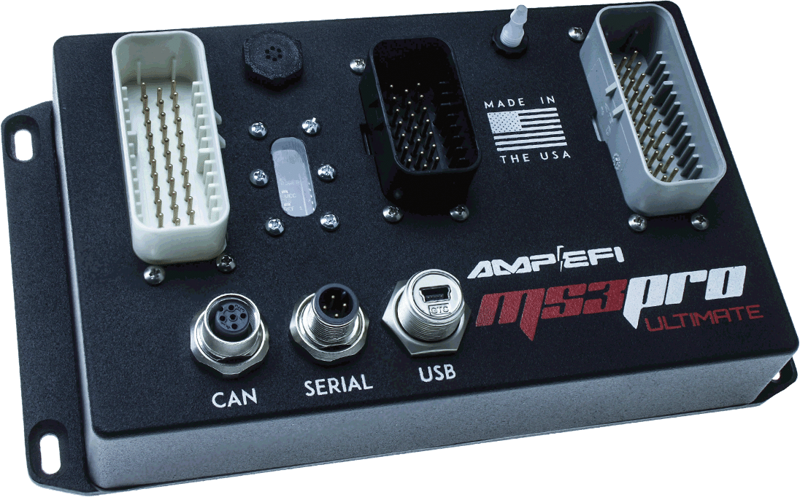
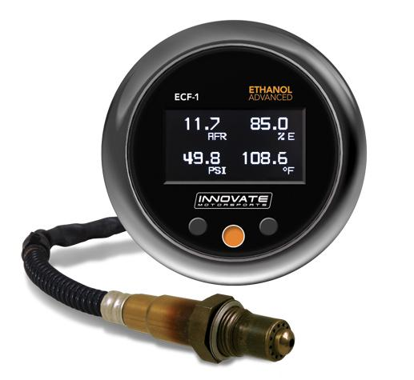
Standalone ECU
Hardware
MS3 Pro Ultimate
Converted stock harness
Innovate ECF-1
Wideband O₂ and ethanol sensor
Software
TunerStudio MS
Custom fuel and ignition tables
MegaLogViewer MS
data logs
Notes:
chose the ms3 because we are inexperienced with tuning, and tunerstudio is easy to navigate.

Slide 9
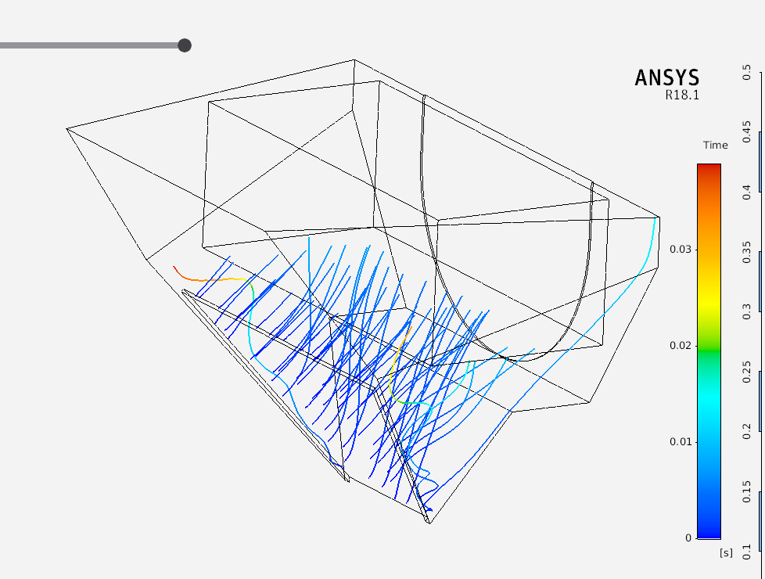
Skid and Body Modifications
Graphite Hyfaxes
Catalyst and nose-cone vents
Sound deadening material addition
Trial | Pulling Force (lbs) Old Polyethylene Hyfax | Pulling Force (lbs) New Graphite Hyfax
1 | 15 | 13
2 | 15 | 12
3 | 14 | 13
4 | 16 | 11
5 | 13 | 12
Graphite Hyfax Testing Results
Nose-cone vent Ansys Analysis
Notes:
Graphite hyfaxes were tested to confirm that they will have a lower coefficient of friction, therefore providing less resistance against the track during operation. The hyfaxes were tested by pulling a skid on a sheet of aluminum with a standard spring force gage. A sheet of aluminum was used to simulate the clips of the track that the hyfaxes would run against.
Vents were added into the plastic to better manage the elevated temps in the engine bay during operation. A vent was added on the exhaust side of the sled where the catalyst is located to provide a steady stream of cool air against the surface of the catalyst. A forward facing vent was also added to provide supplementary cooling to the radiator and intercooler stack up with the FST stock radiator fan. In order to see the results, the nose-cone was simulated in Ansys with a 45 mph/20.11 m/s air stream speed. Initially, the max speed seen in the nose-cone was 26.7 m/s. After the geometry of the nose-cone was changed, the max speed see was 60.3 m/s. With the addition of further data such as the inlet and outlet temps and flowrates of coolant, the team would be able to simulate the thermal effect of the vent on the intercooler and radiator stack up.

Slide 10
Skid and Body Modifications
Notes:
Here is our data from last year. We went with the ⅛” Linex because it had the highest reductions of Decibels. Here is further analysis of sound deadening with various materials including: Plastic, Raam Mating, and Linex.

Slide 11
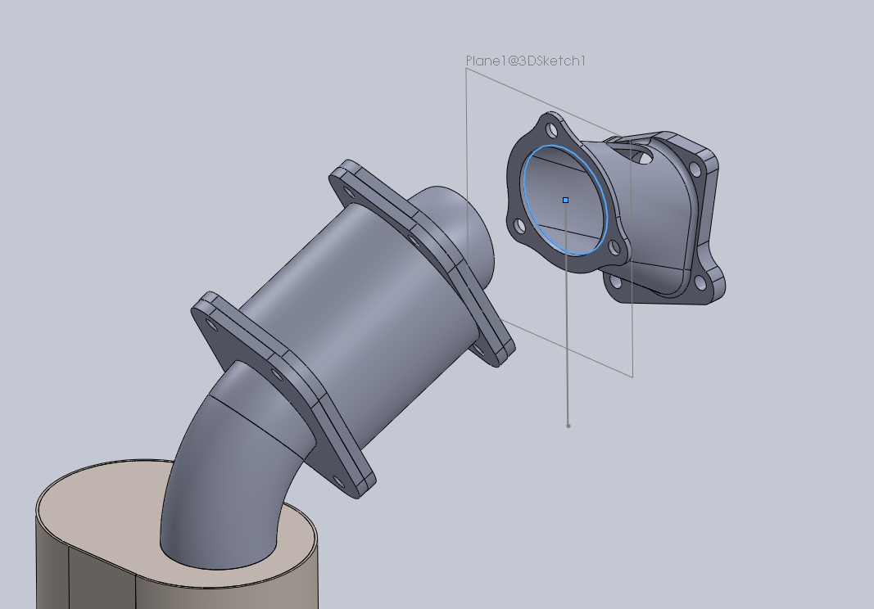
Custom Exhaust
ANSYS Simulation
Exhaust Alignment
 | Operating Temperature °F (°C)
Carbon Steel | 900 (500)
Aluminized Steel | 1200 (650)
304 Stainless Steel | 1400 (760)
420 Stainless Steel/Brz | 1650 (900)
Downpipe
3D Printed, 420 Stainless with Bronze
Catalytic Converter
Aristo Global 3-Way Catalyst
Muffler
Double Walled / Ceramic Fiber Shell
304 Stainless
Tubing
304 Stainless
Fiberglass Exhaust Wrap
Material properties
Notes:
Our baseline readings for the stock exhaust are 77dba which is already a much better improvement over the stock 2 stroke Indy.

Slide 12
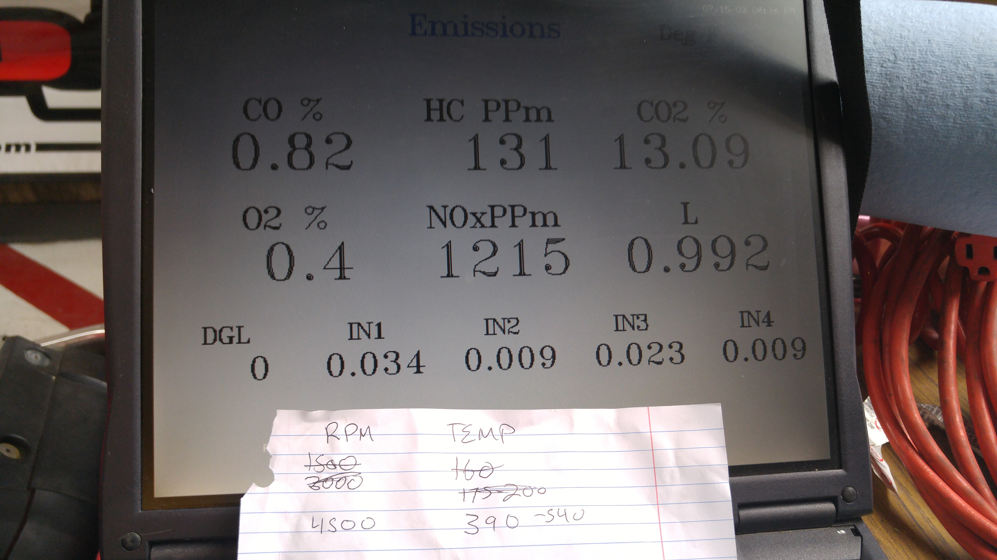
Goals and Lessons Learned
Continue to innovate through simulation software
Give more time for Engine Calibration
Further pursue 4 - stroke engines
Proper catalyst insulation
3D printing as a low production alternative and prototyping option
Electrical team organization
Pursue more effective emissions testing

Slide 13
Questions?

