Slide 1
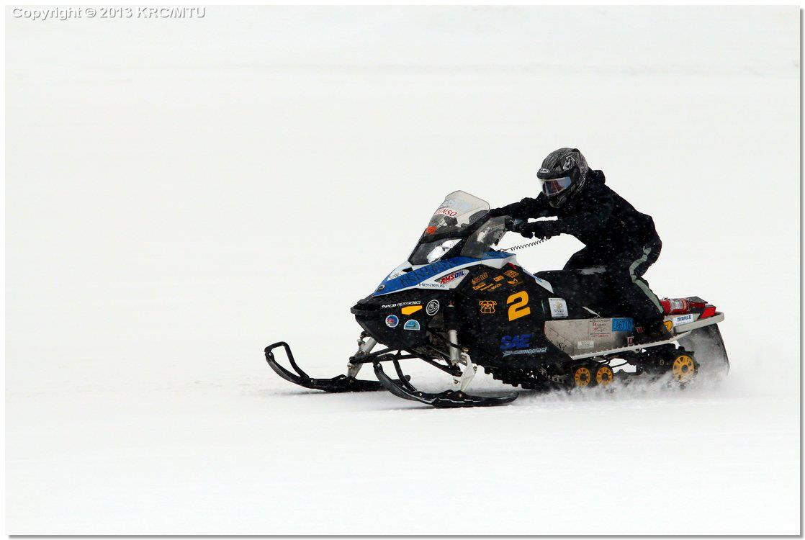
Kettering University
Development of a Flexible Fueled Snowmobile for the 2014 SAE Clean Snowmobile Challenge

Slide 2
Design Approach
Versatility
  Performance 90 hp class snowmobile
  Mode switch increases fuel economy, limits power for inexperienced riders
Advanced Controls
  Electronic Throttle
  Custom engine code
  Infinite flexibility
Noise Attenuation
  Affordable, lightweight silencer with acoustic valve
4. Emissions
  Three way catalyst with application-specific washcoat
  Extended lean-burn calibration
5. Dynamic Performance
  Performance increase over OE model with turbocharged power
  Lightest weight at CSC 2014

Slide 3
Kettering 2014 Skidoo MXZ Sport

Slide 4
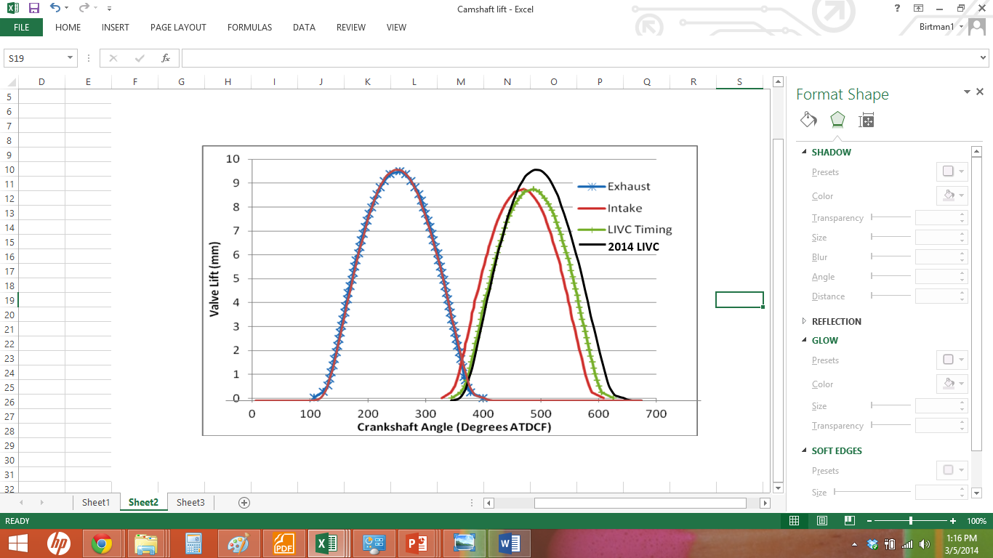
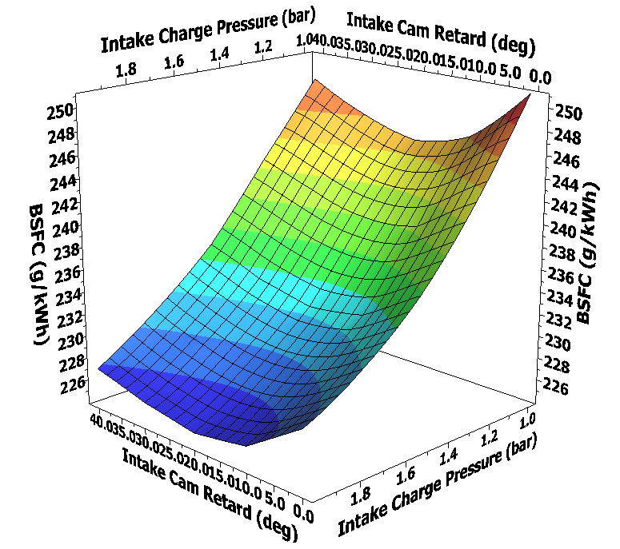
Late Intake Valve Closing
Simulation DOE shows most efficient:
  20 degree intake cam retard from OE
  Increasing intake charge pressure
Exhaust camshaft as intake cam: LC 126 ATDC, IVC 61 ABDC
Turbocharger provides intake charge pressure for efficiency and power

Slide 5
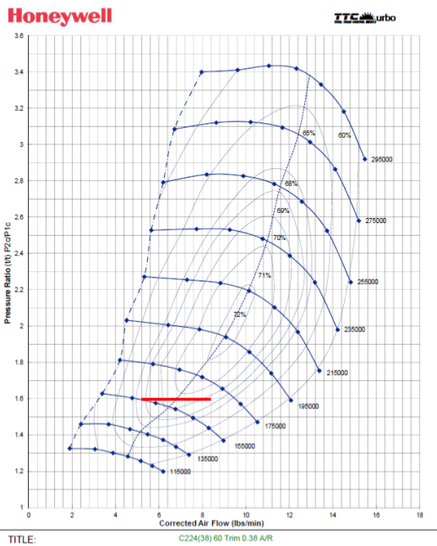
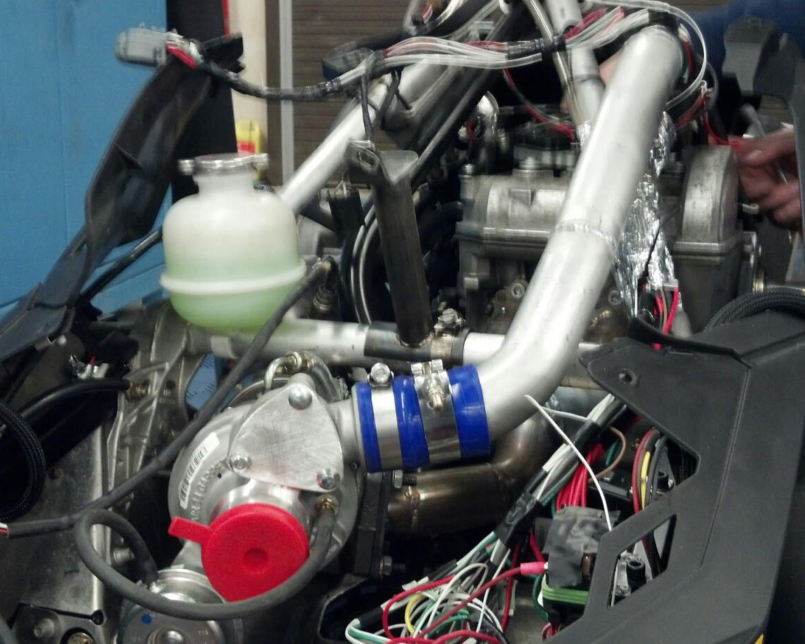
Compressor Matching
Honeywell Garrett MGT1446Z turbocharger
  Larger than traditional compressor match
  Odd-fire twin cylinder engine with large exhaust pulses
  Large turbine wheel and housing for low backpressure

Slide 6
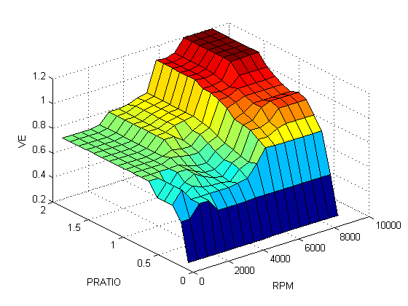
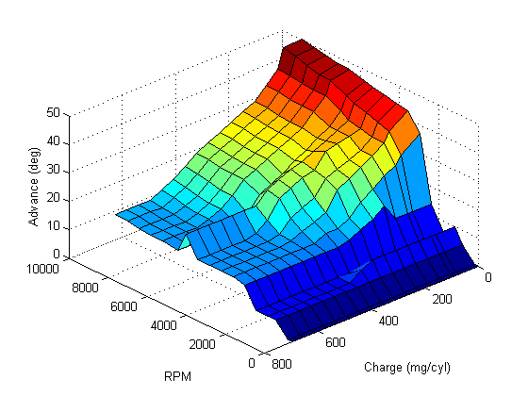
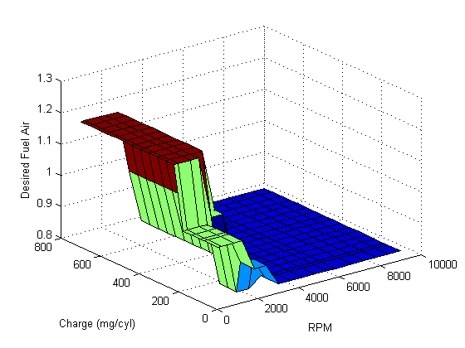
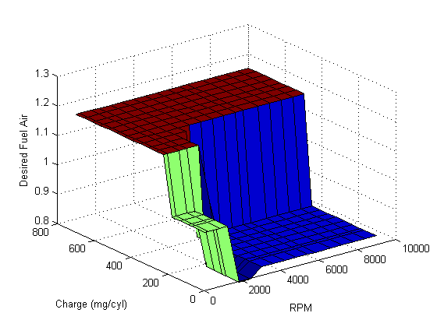
Controls and Calibration
Volumetric Efficiency
Eco Mode Ignition Timing
Perf Mode Fuel-Air Ratio
Eco Mode Fuel-Air Ratio

Slide 7
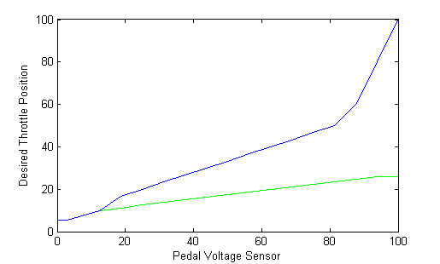
Controls Value Added
Infinite flexibility for maximum value provided to dealers, outfitters, and riders
Performance/economy modes
  Switches throttle, fuel, and spark mapping
  Performance mode capable of 80 hp
  Economy mode limits snowmobile to 50 mph on trail
  Performance mode allows high engine response

Slide 8
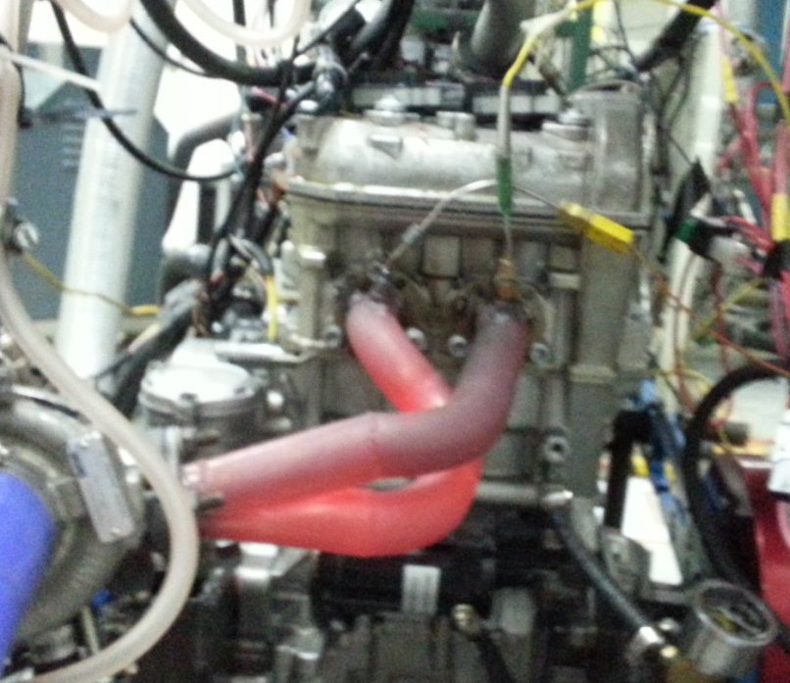
Miller Cycle 600 ACE Engine
Stock 12:1 compression ratio to preserve efficiency
Late intake valve closing for reduced pumping losses
Increased torque with turbocharger boost
Decreased modal BSFC from stock naturally aspirated
Improved vehicle performance—appeals to more riders

Slide 9
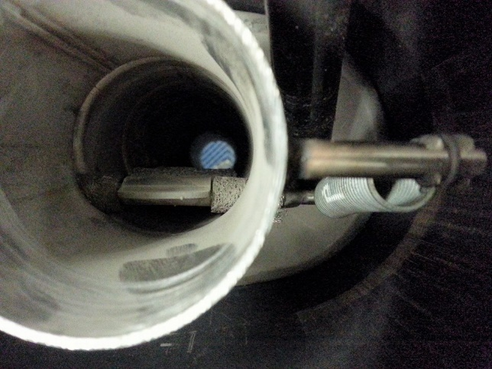
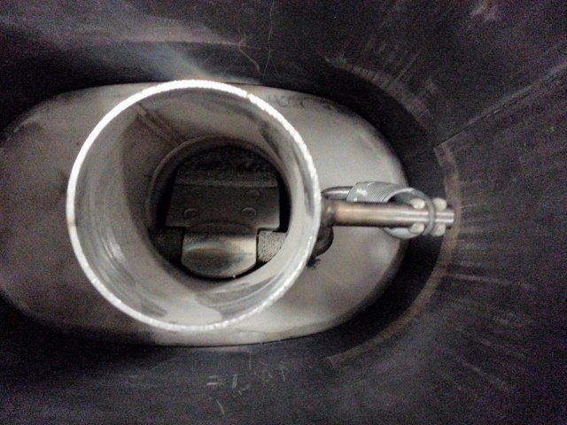
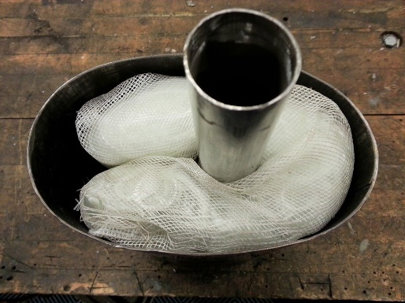
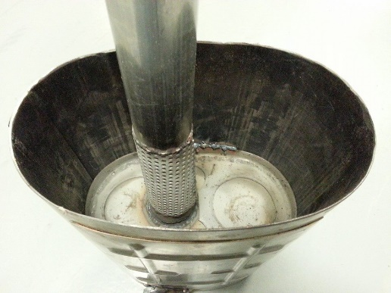
Catalytic Silencer design
Silencer weighs 10 lb, cost is $85.97
Passive acoustic valve is in production on passenger cars
Resistive tuning attenuates low-frequency content
Valve opens with increased mass flow in performance mode
Cont. roving fiberglass, 130 g/l
Stock muffler weighs 16.75 lb, costs $1171 to replace

Slide 10
Results—Emissions
105 x 74.5 mm substrate
1/0/1 Pt/Pd/Rh, 33 g/cu ft.
Oxygen storage for NOx conversion
E-score with catalyst: 205
E-score without catalyst: 190
E-score for BAT: 170

Slide 11
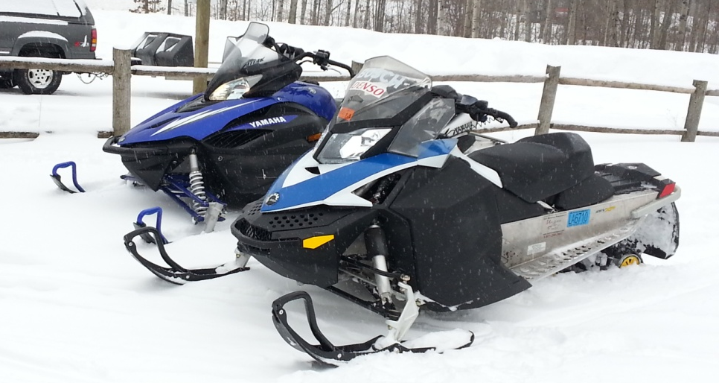
Dynamic Performance--Light Weight
485 lb with fluids, without fuel
Lightest snowmobile at CSC 2014
Performance mode allows high acceleration
Launch and traction control for acceleration and handling
Cost-effective at estimated $9000 MSRP
An efficient, quiet, low-emissions performance trail sled to enjoy in fast company!

Slide 12







Thanks to our 2014 Sponsors!

